Slide 1
Quality Control Basics of Statistical Process Control (SPC) Acceptance sampling Process capability - Attribute and continuous data
BUSI 104 – Operations Management
Professor Ed Arnheiter

Slide 2
Random Variation
When checking for process stability:
when process is unchanged (stable), data will vary in a predictable way
when process has changed (unstable), data will provide clues to both how and why

Slide 3
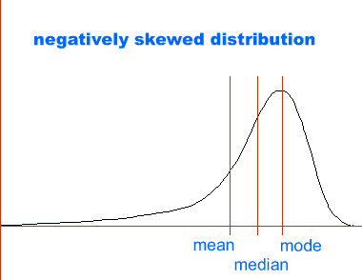
Analysis of Stable Processes
Examine data for:
central tendency - where is process located?
dispersion - how much do outcomes vary?
distribution - pattern (shape) of process variation?

Slide 4
Examples of Process Instability
Process in control
Central tendency out of control
Dispersion out of control

Slide 5
Important Steps
Certify that measurement system is accurate and precise
Calibration
Repeatability and Reproducibility (R&R) analysis, if using measurements data
Inspector error study, if applicable (if collecting count data, or proportion/categorical data)
Establish that process is in control
using appropriate control chart(s)
removal of special causes of instability
Determine distribution of process output
if normal, standard capability indices can be applied

Slide 6
Definition of Subgroup
Subgroup size is number of outcomes in each period of data collection (called n)
Examples:
if data are collected on diameter of part based on a sample of 5 parts taken every 15 minutes, subgroup size is 5
if data are collected on mortality rate at a hospital and reported monthly, the subgroup size is the number of patients admitted in a month

Slide 7
Control Chart of a Stable Process
UCL (upper control limit)
process parameter
Center Line
LCL (lower control limit)
Subgroup
data organized by time of collection
Control limits are based on probability theory, not specifications or goals

Slide 8
Meaning of Random Samples
Data included in points constitute “random” sample.
X
Order from point to point is not random - arranged according to time.
R

Slide 9
Control Charts: Statistical Basis
Control charts are, in effect, a two-sided hypothesis test:
H₀: θ = θ_{o} (value expected, given the presence of strictly random variation)
H₁: θ ≠ θ_{o} (process has changed – look for assignable cause )
Where alpha = 0.0027
When normality can be assumed, multiplier of “3” is used to determine critical region for rejecting H₀
Z
=
Z
=
3
.
00
α
0
.
00135
2

Slide 10
Basic Structure of a Control Chart
μ_{θ}+3σ_{θ}
θ
μ_{θ}
μ_{θ}−3σ_{θ}
Subgroup

Slide 11
Common Attribute Control Charts (OM Explorer can create p-charts and c-charts)
p-chart for proportion nonconforming
np-chart for number nonconforming (sample sizes constant)
c-chart for number of nonconformities (e.g., defects on paper sheet - proportion cannot be computed since we don’t know the total number of possible defects)
u-chart for number of nonconformities per unit (e.g., complex subassemblies with several independent nonconformities per unit)
Proportion Data
Count Data

Slide 12
Random Variation for Proportions
Mean proportion of “successes”
Standard deviation of the proportion of “successes”
Shape of the possible proportions
skewed right when np<5
bell shaped (i.e., normal) when np≥5 and n(1-p)≥5
skewed left when n(1-p)<5

Slide 13
Use of p-Charts
“Known p” - process has already been characterized
“Unknown p”- process has yet to be characterized;
to determine “p”, proportion data are collected and a “trial” p-Chart is created using “average proportion”
if stable, average proportion is used to estimate “p”

Slide 14
p-chart Calculations for Unknown “p”
p-bar is the average proportion
z is the number of standard deviations from the process average
n is the number of items in a subgroup

Slide 15
Office & Cubicle Audit (goal = 85% conforming)
Number of offices or cubicles meeting acceptable standards out of 50 offices/cubicles sampled each week.
20 Subgroups (Samples) in this example, with 50 cubicles in each subgroup.

Slide 16
What are the p-Chart parameters for the office audit sample data? Using Excel or a calculator to find the parameters by hand (Not OM Explorer):

Slide 17
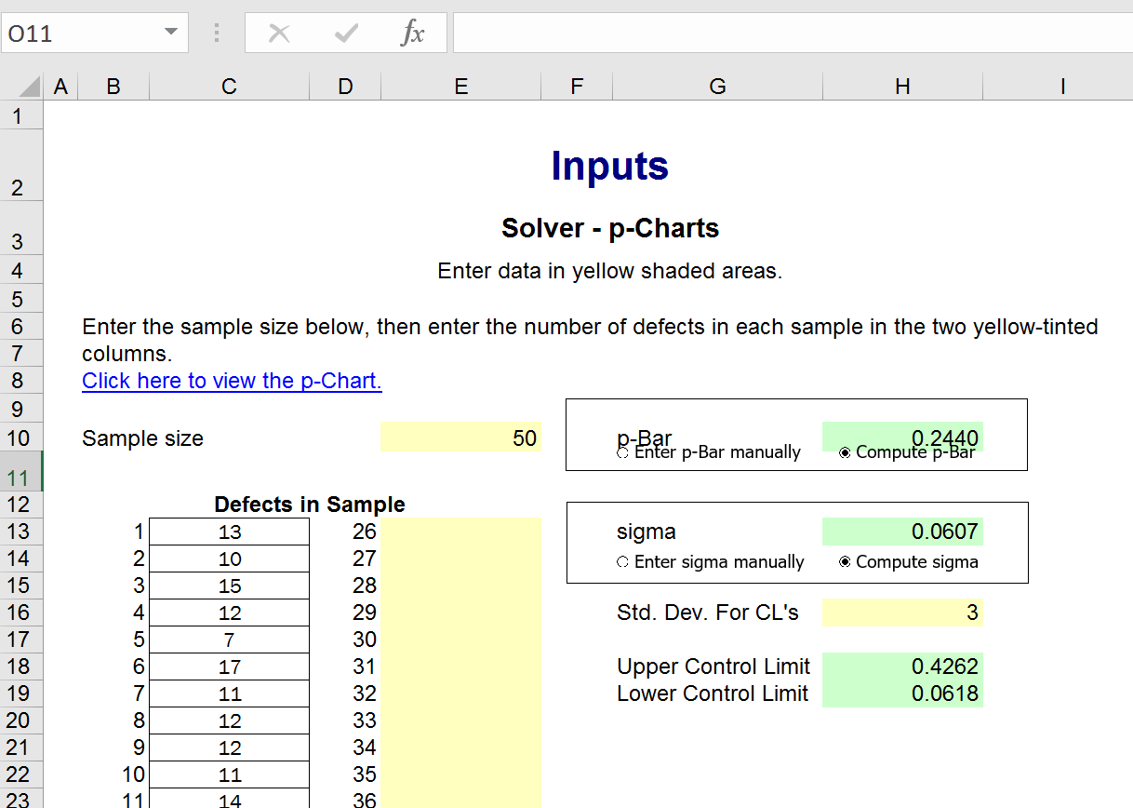
Office Audit Data Creating p-Chart using OM Explorer

Slide 18
Office Audit p-chart as Created by OM Explorer
 | Results
 | Solver - p-Charts

Slide 19
c-Chart for the Number of Nonconformities
c-bar is the process average, or the mean number of defects per item (total number of nonconformities/number of samples)
Notes:
Based on the Poisson Distribution

Slide 20
c-Chart Example
Item | Total # nonconformities | Item | Total # nonconformities
1 | 19 | 15 | 12
2 | 21 | 16 | 9
3 | 23 | 17 | 11
4 | 11 | 18 | 9
5 | 9 | 19 | 9
6 | 8 | 20 | 12
7 | 17 | 21 | 8
8 | 8 | 22 | 11
9 | 8 | 23 | 9
10 | 13 | 24 | 9
11 | 7 | 25 | 18
12 | 5 | 26 | 11
13 | 12 | 27 | 15
14 | 11 | 28 | 9
Periodically, notebook computer is pulled from assembly line and inspected. Total number of imperfections are recorded for each item.
Data for most recent 28 items shown.

Slide 21
Parameters & Interpretation (manual calculations to find parameters, not OM Explorer)
If the number of items in subgroup varied, we could calculate the number of imperfections per item, and create a u-chart

Slide 22
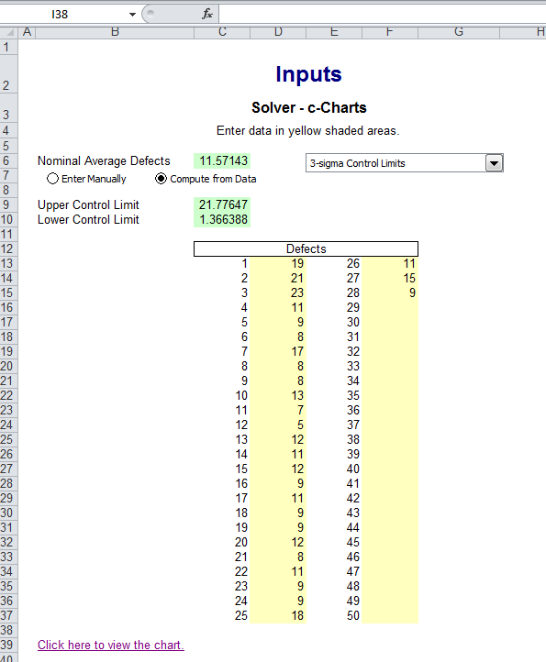
OM Explorer Screen for c-Chart

Slide 23
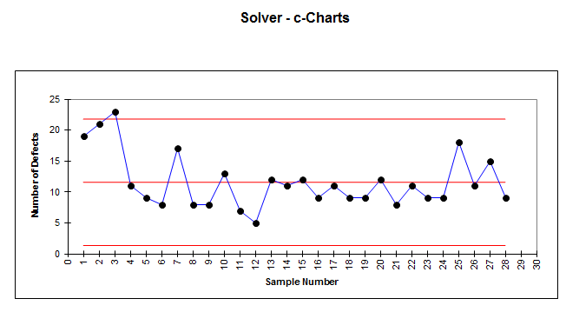
c-Chart for Notebook Computer Total Number of Imperfections on Each Item

Slide 24
p-chart Sample Size Requirements
Data should be sub-grouped and plotted as frequently as possible with at least 20 subgroups.
Subgroup size must be large enough to validate normality assumption; visually is confirmed when:
at least 90% of proportions greater than 0.0, and
at least 90% of proportions less than 1.0
Monthly subgrouping typically used only for very long-term analysis.

Slide 25
Basis for “Zone” Rules Based on Characteristics of Normal Distribution
+3σ
UCL
Zone A
+2σ
Zone B
50%
+1σ
Zone C
Center line
67%
95%
99.7%
Zone C
-1σ
Zone B
50%
-2σ
Zone A
-3σ
LCL

Slide 26
Zone Rules (Pattern Tests) Out of Control Signals
Many software packages, including Minitab, automatically check for patterns in c-charts, p-charts, and X-bar charts, including:
1 point more than 3 SD from CL
9 points in a row on same side of CL
6 points in a row, all increasing or all decreasing
14 points in a row, alternating up and down
Minitab also checks X-bar charts for the following (run rules):
2 of 3 points > 2 SD from CL (same side)
4 out of 5 points > 1 SD from CL (same side)
15 points in a row within 1 SD of CL (either side)
8 points in a row > 1 SD from CL (either side)
Notes:
In general, run rules are never used with p-charts or c-charts. The lack of a strong statistical basis for these run rules is one of the reasons that continuous variable control charts are preferred to attributes charts – there is simply more information available from the continuous variable than from the discrete variable.

Slide 27
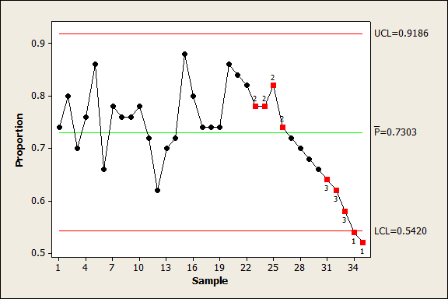
P-Chart with Three Zone Rule Violations (indicating process is NOT in state of statistical control)

Slide 28
Control Charts for Variables
Two types of control charts for variables:
Analyze stability of central tendency
Analyze stability of dispersion
Several possible charts:
Average (X-bar) & Range (R) Charts (OM Explorer can create these)
Average (X-bar) & Standard Deviation (S) Charts
Individuals (I) and Moving Range (MR) Charts
Cusum Charts
Moving Average Charts

Slide 29
Examples of Process Instability
Process in control
Central tendency out of control
Dispersion out of control

Slide 30
X-Bar Charts
Normality of process not required to apply normal probability rules (due to central limit theorem!)
However, process normality is necessary when subgroup size is small (e.g., less than about 4)
x-bar Chart used in conjunction with Standard deviation or Range Chart (i.e., use max minus min).

Slide 31
Standard Deviation Charts The s-Chart
Stability of variation analyzed with s-chart
R-charts not recommended when subgroup size exceeds 4, since range is imprecise measure of variation
Normality of process is necessary
non-normal process may generate violations of zone rules when process is stable
S or R-chart always evaluated in conjunction with X-bar Chart

Slide 32
X-bar & S-charts
Subgroup average
UCL
99.7% of averages
LCL
UCL
99.7% of standard deviations
LCL
Subgroup standard deviation

Slide 33
Table of Control Chart Constants
n | A₃ | B₃ | B₄ | A₂ | D₃ | D₄
2 | 2.659 | 0 | 3.267 | 1.880 | 0 | 3.270
3 | 1.954 | 0 | 2.568 | 1.020 | 0 | 2.570
4 | 1.628 | 0 | 2.266 | 0.730 | 0 | 2.280
5 | 1.427 | 0 | 2.089 | 0.580 | 0 | 2.110
6 | 1.287 | 0.030 | 1.970 | 0.480 | 0 | 2.000
7 | 1.182 | 0.118 | 1.882 | 0.420 | 0.080 | 1.920
8 | 1.099 | 0.185 | 1.815 | 0.370 | 0.140 | 1.860
9 | 1.032 | 0.239 | 1.761 | 0.340 | 0.180 | 1.820
10 | 0.975 | 0.284 | 1.716 | 0.310 | 0.220 | 1.780
11 | 0.927 | 0.321 | 1.679 | 0.290 | 0.260 | 1.740
12 | 0.886 | 0.354 | 1.646 | 0.270 | 0.280 | 1.720
13 | 0.850 | 0.382 | 1.618 | 0.250 | 0.310 | 1.690
14 | 0.817 | 0.406 | 1.594 | 0.240 | 0.330 | 1.670
15 | 0.789 | 0.428 | 1.572 | 0.220 | 0.350 | 1.650
16 | 0.763 | 0.448 | 1.552 | 0.210 | 0.360 | 1.640
17 | 0.739 | 0.466 | 1.534 | 0.200 | 0.380 | 1.620
18 | 0.718 | 0.482 | 1.518 | 0.190 | 0.390 | 1.610
19 | 0.698 | 0.497 | 1.503 | 0.190 | 0.400 | 1.600
20 | 0.680 | 0.510 | 1.490 | 0.180 | 0.410 | 1.590
21 | 0.663 | 0.523 | 1.477 | 0.170 | 0.430 | 1.580
22 | 0.647 | 0.534 | 1.466 | 0.170 | 0.430 | 1.570
23 | 0.633 | 0.545 | 1.455 | 0.160 | 0.440 | 1.560
24 | 0.619 | 0.555 | 1.445 | 0.160 | 0.450 | 1.550
25 | 0.606 | 0.565 | 1.435 | 0.150 | 0.460 | 1.540

Slide 34
Summary of X-Bar, S-Chart, and R-Chart Equations
 | X-bar and S-Chart |  | X-bar and R-Chart
 | X-bar chart | S-chart | X-bar chart | R-chart
UCL
Center Line (CL)
LCL
OM Explorer can create X-bar and R-charts only.

Slide 35
Example: Call Center Waiting Times
Once per shift, six customers are selected at random from all customers who phoned a call center during that shift.
Waiting times, in minutes, for these six random customers were captured.
Data collection process was repeated for next 25 shifts.
Summarized data are shown on next page.

Slide 36
Data for Call Center Example

Slide 37
X-Bar and R-Chart Calculations for Call Center Example
For X-bar Chart:
UCL =
LCL =
For R-Chart:
UCL =
LCL =

Slide 38
X-bar & R for Call Center Data - Minitab (Cannot draw in OM Explorer; max of 20 subgroups)

Slide 39
X-Bar & S Calculations for Call Center Example
For X-bar Chart:
UCL =
For S-Chart:
UCL =
LCL =

Slide 40
Minitab Output (OM Explorer does not have X-bar & S Feature)

Slide 41
Example – Spring Tension
The data below were collected from final inspection of springs:
These data are provided in Excel format within Canvas
Based on the X-Bar and R charts for this process,
is the process in control?

Slide 42
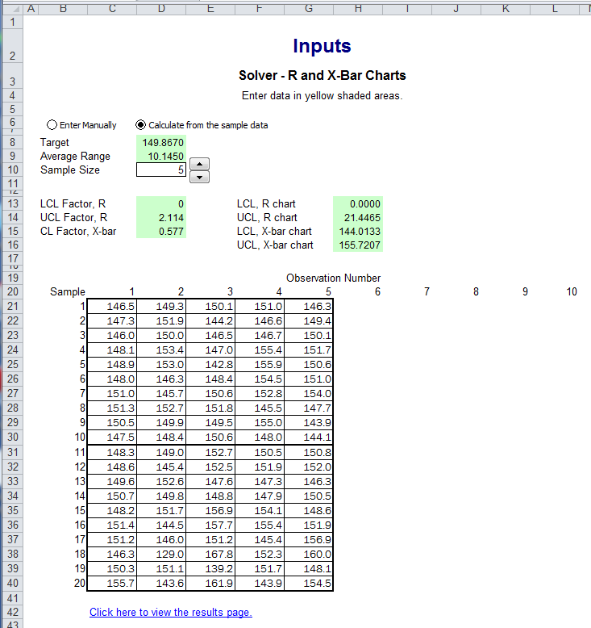
OM Explorer Window for Spring Tension Data
Note slight differences in control chart constants versus table values:
0.580 vs. 0.577
2.110 vs. 2.114
Notes:
Ended here on 3/1/16

Slide 43
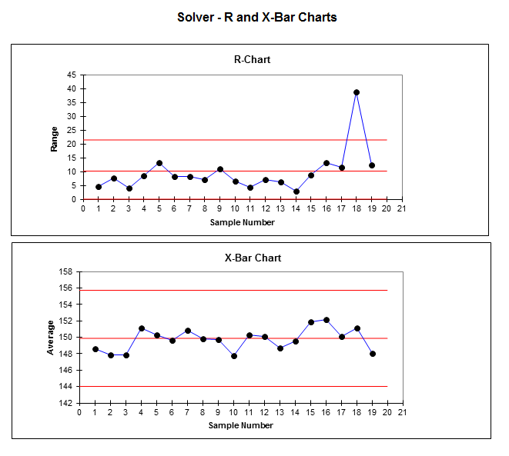
Spring Tension Results

Slide 44
“Rational” Subgroups
Organize to detect instability
want any changes to occur between subgroups
want to identify special causes when they occur
Avoid mixing streams of output into one channel for subgrouping
one set of charts per shift, tool, pre-form, etc. (This could be a potential problem in the Call Center example)
Identification of assignable or special causes aided by:
Process knowledge
good data collection procedures (notes, etc.)

Slide 45
Acceptance Sampling
A product (or outcome) approach to quality management often used for:
incoming inspection for supplier quality assurance
final inspection of product
in-process inspection (as alternative to control charts)
Typically, this approach involves:
infrequent sampling (usually after production is complete)
no accounting for time of production
little or no guidance in identifying problems

Slide 46
Product Assessment Options
No inspection (Deming called “0% inspection”)
generally used when process controls are in place and inspection is expensive or destructive
Sampling inspection
traditional acceptance sampling approach
100% inspection
generally used when external failure costs are high relative to inspection costs
Multiple or redundant 100% inspection
generally used when field failures can result in death or litigation (and inspector error exists)

Slide 47
100% Inspection Exercise (In one minute, count the total number of f's in the paragraph below)
The necessity of training farm hands for first class farms in the fatherly handling of farm live stock is foremost in the minds of farm owners. Since the fore fathers of the farm owners trained the farm hands for first class farms in the fatherly handling of farm live stock, the farm owners feel they should carry on with the family tradition farm hands of first class farms in the fatherly handling of farm live stock because they believe it is the basis of good fundamental farm management.
Notes:
36, u say 38

Slide 48
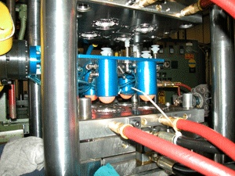
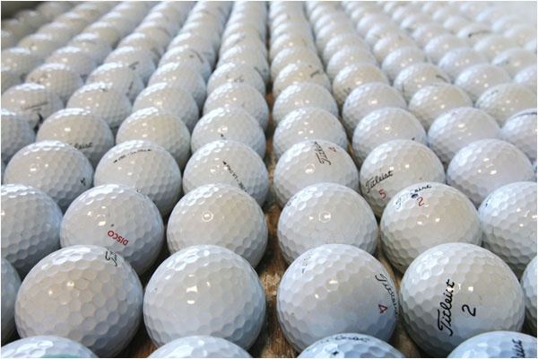
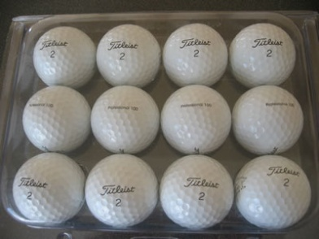
Acceptance Sampling Example
Injection Molding Process Produces Golf Balls
The Production Lot is size N.
Random sample of size n is drawn from N balls and is inspected.

Slide 49
Use of Acceptance Number, c
Acceptance sampling most often uses attribute inspections (classifying items as good or bad)
Typical “single sampling”: inspect each item in sample (size n), and reject lot if number of nonconforming items found in sample exceeds an acceptance number (c)

Slide 50
Standard Acceptance Sampling Logic
Lot is produced or received
No
Select and inspect n items
Reject entire Lot
Send back to producer
Yes
Accept entire Lot
Deliver to customer (internal or external)
D = number of nonconforming items in sample

Slide 51
Questions
If we use c = 0, can we guarantee perfect quality?
If sample size, n, is smaller, is it easier to accept a bad lot?

Slide 52
Acceptance Sampling Errors
Type I error - lot is acceptable, but is rejected
probability of Type I error = α
α is referred to as producer’s risk
Type II error occurs when lot is unacceptable, but is accepted
probability of Type II error is denoted by β
β is referred to as consumer’s risk

Slide 53
Attributes Inspection
For proportion data (fraction nonconforming in lot is p), binomial probability model can be used to forecast acceptance sampling plan results:
Probability of Acceptance = P_{a}
In Excel: BINOMDIST(c,n,p,true) = P_{a}
Method is valid as long as n is no more than 15% of the lot size.

Slide 54
Using Binomial Distribution to Estimate Probability of Acceptance
Consider acceptance sampling plan for pass/fail quality characteristic, where n=20 and c=1 [This can be called a (20,1) plan]
The probability that a lot with 5% nonconforming items (i.e., p = .05) is accepted is approximately

Slide 55
Operating Characteristic (OC) Curves for Various Sampling Plans

Slide 56
The “Ideal” OC Curve
1.0
In this example, every lot with quality less than or equal to 1.5% defective would be accepted. All lots having a quality level worse than 1.5% defective would be rejected.
P_{a}
0
0
1.0%
2.0%
3.0%
4.0%
p

Slide 57
Acceptable Quality Level (AQL)
For attribute-based acceptance sampling plans, acceptability of a lot is specified using an AQL
Note that p is the average rate of nonconformances in the lot
for proportion data, p=fraction nonconforming
for count data, p=average unit count

Slide 58
Official Definition of “AQL”
“The maximum percent nonconforming (or the maximum number of nonconformities per hundred units) that, for purposes of sampling inspection, can be considered satisfactory as a process average.”
The probability of acceptance (P_{a}) for an AQL lot should be high.

Slide 59
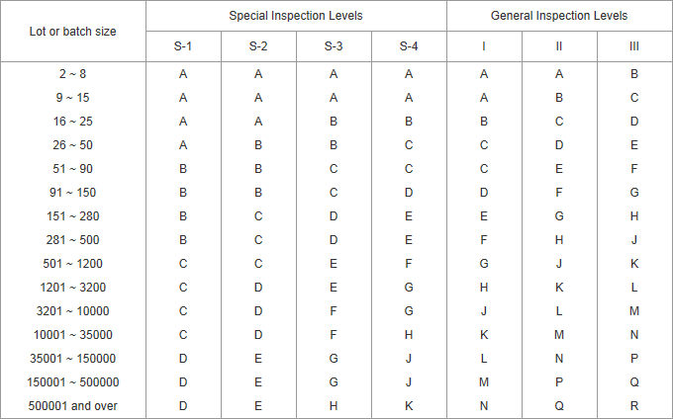
Typical Sample Code Letters ANSI-ASQ Z1.4 Attribute Sampling Tables (also known as Mil-Std-105)

Slide 60
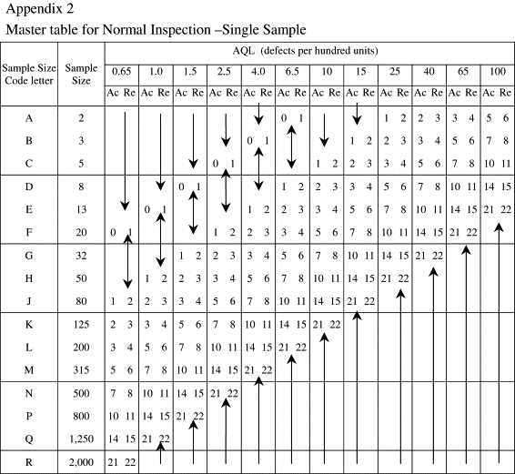
There are also inspection tables for tightened, and/or reduced plans

Slide 61
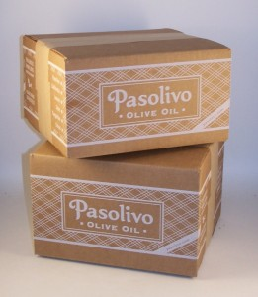
Acceptance Sampling Plan Example
Corrugated boxes are being purchased from a supplier in lot sizes of approximately 200 items. The supplier adds custom artwork to each box. Management wants confidence that the artwork is correct, but cannot afford to check every box in the lot. Instead, the company decides to use acceptance sampling, specifying a 1.0% A.Q.L. Purchasing needs to select the proper sampling plan, assuming General Inspection Level II, normal inspection.

Slide 62
Sample size code G
Sample size 32
In AQL = 1.0 column, follow arrow down to next row, where
Ac = 1
Re = 2
Since we accept on 1, and reject on 2, this plan is denoted as (32,1)

Slide 63
Process Capability Indices Attribute Quality
dpu is best overall measure to focus on for quality improvement purposes – dpu can be multiplied by 100 to get percent defects.
Opportunities is number of value-added entities or features of a part, product, or service that must be met or done right (highly dependent on context and must be defined precisely).
dpm or dpmo = defects per million opportunities. Also called ppm = parts per million defective.

Slide 64
How do you Measure Opportunities?
Assessing correct number of opportunities in process
In punching plates of steel to be formed into door frames, each plate has several specific angles of cuts. If any one angle is bad, most likely entire plate is scrapped. Therefore, entire plate pattern should be one opportunity.
In manufacturing car, many opportunities for errors. But often, a part can fail but car or system can still operate. Therefore, it is appropriate to count value added entities of this process.
Attempt to:
Correctly measure complexity of product or process.
Opportunities represent value added entities or aspects of product, part, process, or service that must be met or done correctly.
Measuring opportunities allows us to compare or benchmark processes with various complexities.
Simplify process:
For products, opportunities may be number of parts making up the process;
For processes, opportunities may be number of value added steps in process.

Slide 65
Exercise for Attribute Measures of Quality
AAA Baking Company looks at five primary quality attributes when making loaves of sliced white bread (these are critical entries - an opportunity for a defect, mistake, or error). An inspection of 1500 loaves revealed a total of 98 defects, and 94% of the loaves were good (i.e., defect free).
dpu =
dpo =
dpmo =
σ_{capability} =
To convert dpmo into σ_{capability}
$$σ_{Cap}=0.8406+\sqrt{29.37−2.221\left[ln(dpmo)\right]}$$

Slide 66
Defects Per Opportunity (dpo) Sample of 15 Medical Records (5 OFDs per record)
Record No. | Coding Error | Signature and Date | Medical History | Primary Care Doctor | Insurance Policy Info. | “Defective” | Number of Mistakes per Record
1 | X | X |  |  |  | Yes | 2
2 |  |  |  | X |  | Yes | 1
3 |  |  |  |  |  | No | 0
4 |  | X |  |  | X | Yes | 2
5 |  |  |  |  |  | No | 0
6 | X |  | X |  |  | Yes | 2
7 |  |  |  |  |  | No | 0
8 |  |  |  |  |  | No | 0
9 |  |  |  |  |  | No | 0
10 |  | X |  |  | X | Yes | 2
11 |  |  |  |  |  | No | 0
12 |  |  |  |  |  | No | 0
13 |  |  |  |  |  | No | 0
14 |  |  | X | X |  | Yes | 2
15 |  |  |  | X | X | Yes | 2

Slide 67
Exercise for Attribute Measures of Quality
From the previous page, for the medical record sample data, the attribute measures are as follows:
dpu =
dpo =
dpmo =
σ_{capability} =
Approximation equation for σ_{capability} calculation:
$$σ_{capability}= .8406+ \sqrt{29.37−2.221[\ln\left(dpmo\right)]}$$

Slide 68
Sigma Capability Versus dpmo Attribute Data (process mean shifted by +/- 1.5 sigma from target)
Bread company example

Slide 69
Process Capability Indices Variable Data; C_{pk}
To use these equations, we must have specification limits (i.e., variable data such as inches, mm, kg, volts, etc.).
Actual process capability index based on the current process:
(Put into Bracket each and then both)
This is the proportion of natural tolerances (3σ) between the mean of the process and the nearest specification.

Slide 70
Process Capability Indices for Variable Data; C_{p}
To use these equations, we must have specification limits (i.e., variable data such as inches, mm, kg, volts, etc.).
Potential process capability Index – the best the process would be if the process average were centered:

Slide 71
Process Capability Example
For Long Term Capability – Estimate σ using sample standard deviation equation (+STDEV.S in Excel).
IF:
Process mean = 77.4, σ estimate = 5.903
USL = 88, LSL = 70, n = 80.
Then:
C_{pk} =
And:
C_{p} =

Slide 72
Process Capability Example (Cont.)
σ_{capability} = Best Sigma Level if process were centered = 3C_{p}
Then, in our example:
σ_{capability} =
σ_{level} = the number of SD’s between mean of the process and the nearest specification:
Then, in our example:
σ_{level} =

Slide 73
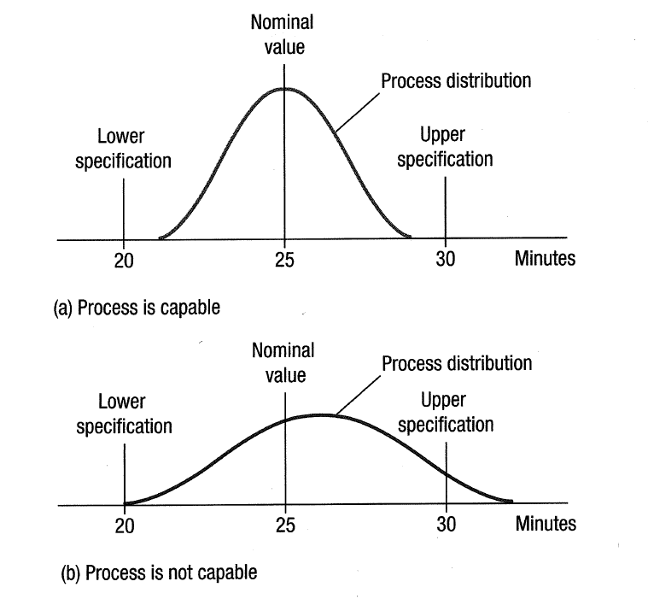
Relationship Between Process Distribution and Spec Limits

Slide 74
More on C_{pk}
Measures how well process is centered relative to specifications, as well as whether variability is acceptable
Typically, +/- 3 standard deviations is used as benchmark
Checks to see if process average is at least three standard deviations from USL and LSL
Minimum of two ratios is used because it is worst-case situation

Slide 75
More on C_{pk}
Compare to critical value to judge whether process is capable.
If striving to achieve 3-sigma performance use critical value 1.0
If targeting 4-sigma performance use 1.33 (or 4/3)
If targeting 5-sigma performance use 1.67 (or 5/3)
If targeting 6-sigma performance use 2.00 (or 6/3)
Processes producing services or products with less than 3-sigma performance will have C_{pk} < 1.0

Slide 76
Example – Critical Value
Suppose a particular process has a C_{pk} = 1.42. The firm desires its processes to produce at the level of 4-sigma performance. What can we conclude about the process?

Slide 77
Process Capability Example PPM Estimate
Area in tails above USL or below LSL represents defective items
LSL = 70
USL = 88
X-bar =
77.4
Z_{u} =
(Same as our two possible σ_{level} values from the previous slide)
Z_{L} =

Slide 78
Example Continued PPM Estimate
Standard Normal Distribution
N(0,1)
Z_{L}
Z_{U}
-1.2536
0
1.7957
NORM.S.DIST(1.7957,true) =
NORM.S.DIST(-1.2536,true) =
Therefore:
PPM =

